Slide 1
Phrase Structure and X-Bar Theory
Presented By:
Afshan Rizwan

Slide 2
X-Bar Theory
X-bar theory was developed in the 1970s to design phrase structures in a more theoretically sound way.
First presented by Chomsky (1970).
More extensively developed by Jackendoff (1977).
X-bar theory seeks to be general.

Slide 3
Cont…
©Andrew Carnie, 2006
X-bar theory makes the claim that every single phrase in every single sentence in the mental grammar of every single human language, has the same core organization.
It is a component of linguistic theory which attempts to identify syntactic features presumably common to all those human. languages.

Slide 4
Key Concerns
©Andrew Carnie, 2006
Can we define phrase structure rules in a way that cross-linguistic properties of syntactic structures?
Can we define phrase structure rules in a way that allows to capture commonalities in structure within a language? (cross-categorial)
Can we define phrase structure rules in a way that distinguishes complements from adjuncts?

Slide 5
Generalization 1: 3 types of rules
©Andrew Carnie, 2006
For each major category there are 3 types of rules: A rule that generates the phrase NP →(D) N'
A rule that iterates: N' → (AP) N'
A rule that introduces the “head” N' → N (PP)

Slide 6
Generalization 1: 3 types of rules
©Andrew Carnie, 2006
For each major category there are 3 types of rules: A rule that generates the phrase NP →(D) N'
A rule that iterates: N' → (AP) N'
A rule that introduces the “head” N' → N (PP)
Specifier rule

Slide 7
Generalization 1: 3 types of rules
©Andrew Carnie, 2006
For each major category there are 3 types of rules: A rule that generates the phrase NP →(D) N'
A rule that iterates: N' → (AP) N'
A rule that introduces the “head” N' → N (PP)
Specifier rule
Adjunct rule

Slide 8
Generalization 1: 3 types of rules
©Andrew Carnie, 2006
For each major category there are 3 types of rules: A rule that generates the phrase NP →(D) N'
A rule that iterates: N' → (AP) N'
A rule that introduces the “head” N' → N (PP)
Specifier rule
Adjunct rule
Complement rule

Slide 9
Generalization 2: Headedness
In each rule the only item that is obligatory is the item that gives its category to the node that dominates it:
NP →(D) N'
N' → (AP) N'
N' → N (PP)
Endocentricity, meaning that every phrase has a head. The only obligatory element in a phrase is the head)

Slide 10
Generalization 3: Optionality
©Andrew Carnie, 2006
With the exception of determiners, all non-head material is both phrasal and optional
NP →(D) N'
N' → (AP) N'
N' → N (PP)

Slide 11
The X-bar Rules (to be slightly revised)
©Andrew Carnie, 2006
Specifier Rule:
XP →(YP) X'
Adjunct Rule: X' →(ZP) X' or X' → X' (ZP)
Complement Rule: X' → X (WP)
where X can stand for any category (N,V, Adj, Adv, P). X must be consistent through the 3 rules.

Slide 12
Specifiers
Specifiers are used to narrow the meaning intended by the head. They include:
articles: the (book), a (book), etc.
possessive determiners: my (book), your (book), etc.
demonstrative determiners: this (book), that (book), etc.
quantifiers: no (answer), every (hour), etc.
Specifier rule: X' → X' (YP)

Slide 13
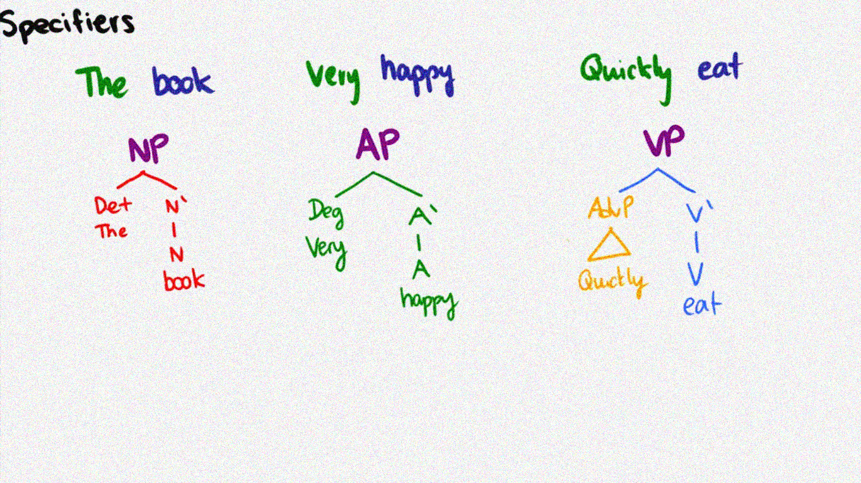
Specifier Examples
Sister to X' and daughter of XP.

Slide 14
Complements
Complement is the sister to a head (X,N,A,V,P) and a daughter of a single bar level (X').
They cannot stand next to the word one.
Complements are used to complete the meaning intended by the head. They may be:
▪ direct objects: (do) something, (give) something
▪ indirect objects: (laugh at) something, (give to) someone
▪ complement of adjectives: (loyal) to the queen, (interested) in Chemistry
▪ complement of adverbs: (independently) from her
Complement rule X' → X (WP)

Slide 15
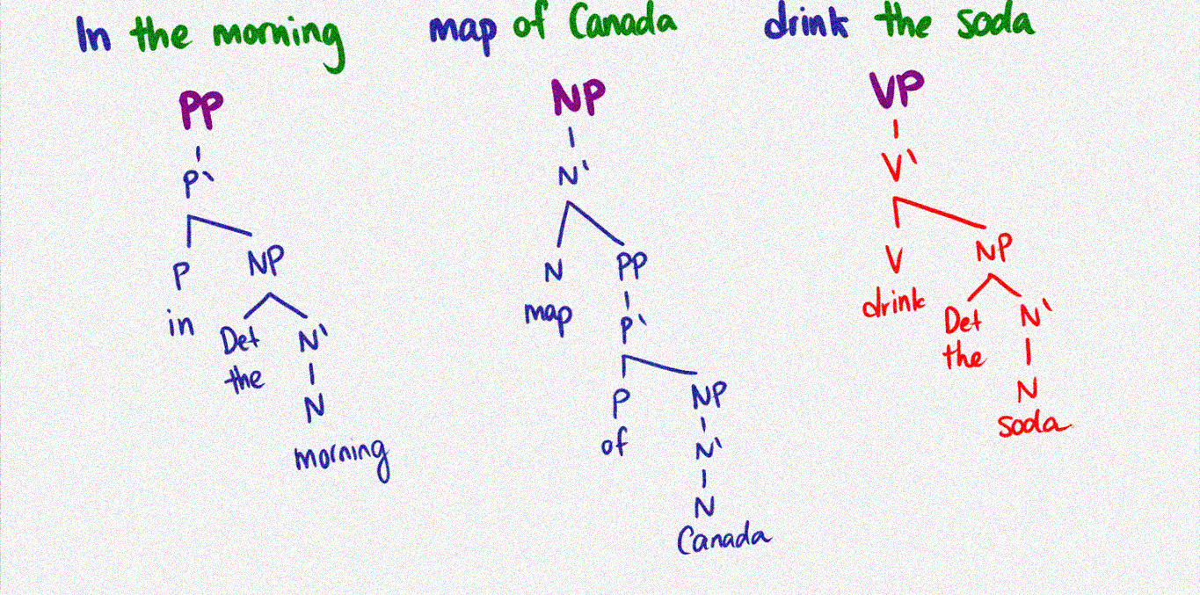
Complement Example
Sister to X and daughter of X'.

Slide 16
Adjuncts
An XP that is the sister to bar level (N',A',V',P') and daughter of a single bar level (N',A',V',P').
Sister to X' and daughter of X'.
Adjuncts are used to modify the meaning intended by the head:
▪ adjectives: beautiful (table)
▪ adverbs: (speak) slowly
▪ prepositional phrases: (table) of wood
Adjunct rule: X' → X' (ZP)

Slide 17
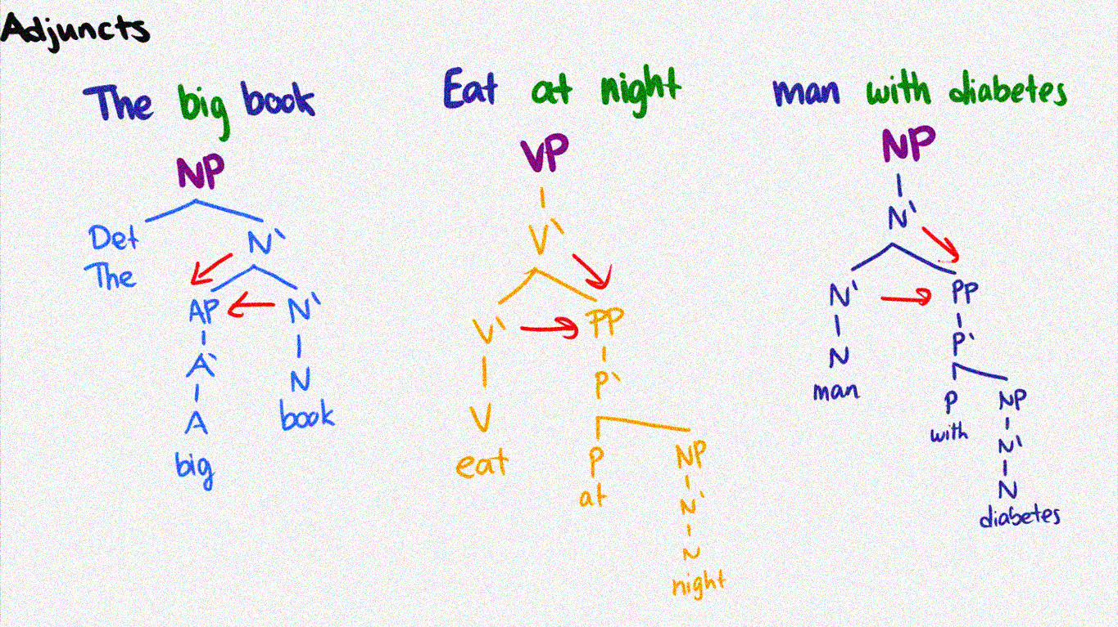
Adjunct Example
Sister to X' and daughter of X'.

Slide 18
Let's Draw it!
the map [of Canada] [with a glossy legend]
Eats [dinner] [with his wife]

Slide 19
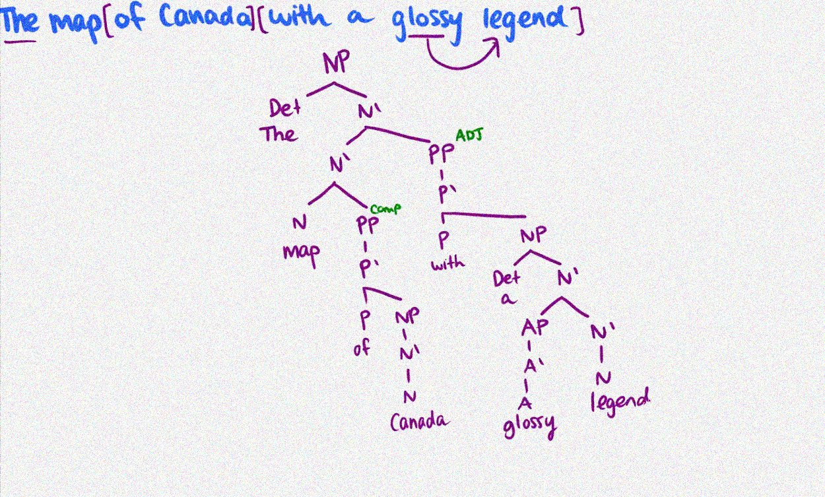

Slide 20

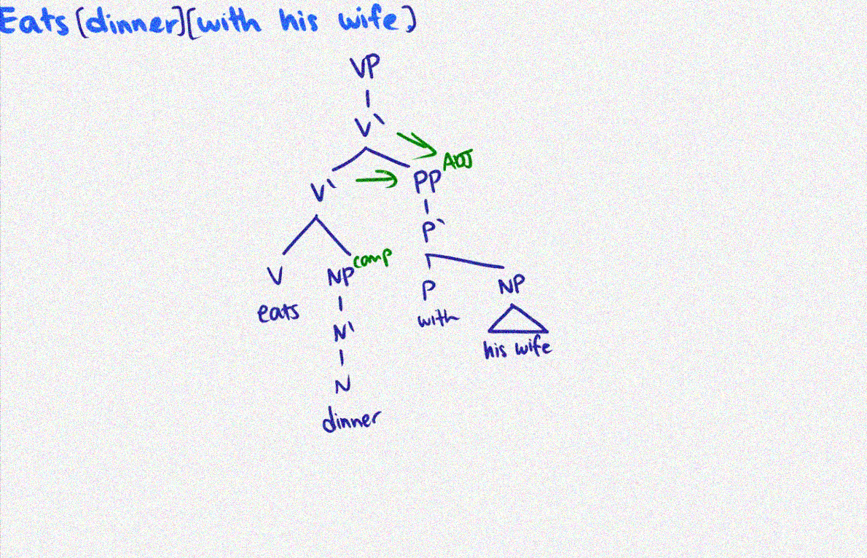
Eats [dinner] [with his wife]

Slide 21
X-bar Structures
©Andrew Carnie, 2006
XP
YP
X'
X'
ZP₁
X'
ZP₂
X
WP

Slide 22
N' Structure
NP
D
the
N'
AdjP N'
tall
N'
PP
N
student
PP
with red hair
of physics

Slide 23
N' Rules
©Andrew Carnie, 2006
NP → (D) N'
N' → (AP) N'
N' → N (PP)
or N' (PP)

Slide 24
One-Replacement
©Andrew Carnie, 2006
Replace an N' node with [one]
not N, not NP

Slide 25
One replacement
NP
D
the
N'
AdvP N'
tall
N'
PP
N
student
PP
with red hair
of physics

Slide 26



One replacement
©Andrew Carnie, 2006
NP
D
the
N'
AdvP N'
tall
N'
PP
the short [one] with brown hair
N
PP
with red hair
student
*the short [one] of chemistry
of physics

Slide 27
V' Structure
VP
V'
AP
V'
V'
PP
often
V'
AdvP
in church
V
sings
NP
loudly
opera
©Andrew Carnie, 2006

Slide 28
V' rules
©Andrew Carnie, 2006
VP → V'
V' → (AP) V' or V' ({AP/PP})
V' → V (NP)

Slide 29
Do-so replacement
replace a V' node with [did so ]
not VP, not V

Slide 30
John often sings opera loudly in church and/but Mary ...
VP
V'
AP
V'
V'
PP
often
V'
AdvP
in church
V
sings
NP
loudly
opera

Slide 31

John often sings opera loudly in church and/but Mary ...
VP
V'
AP
V'
V'
PP
often
V'
AdvP
in church
V
NP
loudly
sings
opera
*Ali does so folksongs quietly in the library

Slide 32
John often sings opera loudly in church and/but Mary ...
©Andrew Carnie, 2006
VP
V'
AP
V'
V'
PP
often
V'
AdvP
Ali [does so]
in church
quietly in the
library
V
sings
NP
loudly
opera
*seldom does so folksongs quietly in the library

Slide 33
John often sings opera loudly in church and/but Mary ...
©Andrew Carnie, 2006
VP
V'
Ali [does so] in the library
AP
V'
V'
PP
often
V'
AdvP
seldom [does so]
in church
quietly in the
library
V
sings
NP
loudly
opera
*seldom does so folksongs quietly in the library

Slide 34
Further Evidence for V'
VP
V'
V'
PP
V' Conj V' and
P
with
NP
V NP V NP
eats tosses
a fork
beans
salads

Slide 35
P' Rules
©Andrew Carnie, 2006
P P → P'
P' → (AdvP) P' or P' (PP) P' → P (NP)

Slide 36
P' Structure
PP
P'
P'
PP
NP
with her boss
love
©Andrew Carnie, 2006

Slide 37
What about AdjP and AdvP
©Andrew Carnie, 2006
Is there intermediate structure in AdjP and AdvPs?
There certainly are adjuncts:
Jhon is interested in syntax but less [so] in phonology

Slide 38
What about AdjP and AdvP
©Andrew Carnie, 2006
AP → A'
A' → (AP) A’ or A' (PP)
A' → A(PP)
The equivalent set of rules for Advs & Adjs

Slide 39
A' Structure
AP
A’
AP A’
bright A
blue

Slide 40

The New Rules (to be revised)
NP → (D) N'
N' → (AP) N'
N' → N (PP) VP → V'
V' → (AP) V' or
V' → V (NP)
AP → A'
or N' (PP)
^{V' ({AP/PP})}
A’ → (AP) A'
A’ → A(PP)
PP → P'
P' | → (AP) P' | or | P' (PP)
P' | → P (NP)

Slide 41
Goals of X-bar theory
©Andrew Carnie, 2006
Simplify the system of rules Capture intermediate structure
Capture the cross-categorial generalizations.
We will use VARIABLES to do this. A variable is a category that can stand for any other category.
X,Y,W, Z are variables that can stand for ANY of N,V,A,P

Slide 42
Conclusion
X-bar theory provides us with an avenue for exploring the differences and similarities among languages.
It is a method of sentence analysis that divides the sentence into constituents, but it states some very specific rules for doing that.

Slide 43
Cont..
In particular, x-bar theory introduced the intermediate levels of structure called N', V', A' and P’. The evidence for these comes from standard constituency tests like conjunction, and from processes like one-replacement, and do-so-replacement.

Slide 44
Cont…
We also saw that material on different levels of structure behaved differently.
Next we observed that our rules were failing to capture several generalizations about the data.
Next, there was the observation that all trees have three levels of structure. They all have specifiers, adjuncts and complements.

Slide 45


